Slide 1
Overview of Peripherals (Theory)
Printers: Output devices used to transfer digital text and graphics onto physical media like paper or transparency sheets. Common types include inkjet printers for everyday color documents, laser printers for high-speed monochrome office use, and dot-matrix printers for multi-part continuous forms using mechanical impact pins.
Scanners: Input devices that optically capture physical documents, photographs, or drawings and convert them into digital computer files. Common variants include flatbed scanners for bound books and photos, and sheet-fed scanners for automated multi-page loose document processing.
Webcams: Input devices that capture real-time video and audio streams for virtual communication, video conferencing, online education, and live streaming.
Connection Interfaces: The physical ports and wireless protocols used to link peripherals to the computer system, primarily including USB (for direct wired data transfer), Wi-Fi (for network-based wireless printing and scanning), and Bluetooth (for short-range wireless pairing).

Slide 2
Table of Peripherals and Real-Life Use Cases
Category | Device Type | Real-Life Use Case
Printers | Inkjet Printer | Printing color college assignments and photographs at home.
 | Laser Printer | Printing bulk invoices and high-volume documents quickly in a corporate office.
 | Dot-Matrix Printer | Printing multi-copy railway tickets or bank passbooks using mechanical impact pins.
Scanners | Flatbed Scanner | Digitizing old physical photographs or textbook pages by placing them flat on the glass.
 | Sheet-Fed Scanner | Rapidly scanning single-sided tax documents or loose financial sheets through an automatic feeder.
Webcams | Conference Webcam | Attending online lectures and virtual business meetings via Zoom or Microsoft Teams.
 | Streaming Webcam | Broadcasting live gameplay or interactive content to platforms like YouTube or Twitch.

Slide 3
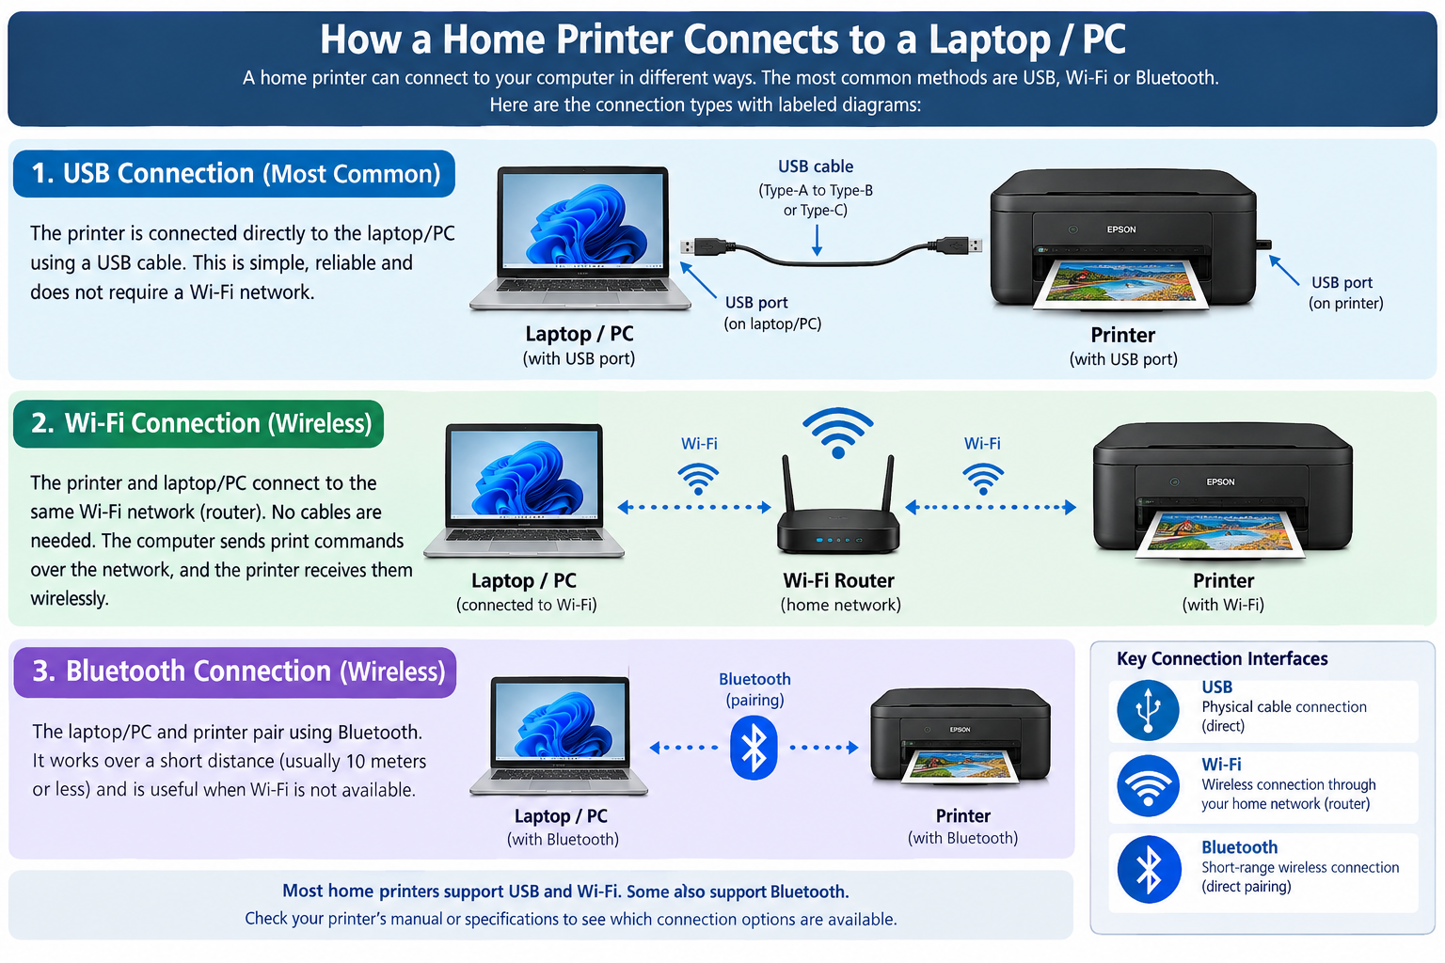

Slide 4
Comparison of Connection Interfaces
USB (Universal Serial Bus):
  Advantage: Delivers high data transfer speed and universal plug-and-play compatibility across almost all modern PCs and peripherals.
  Disadvantage: Physical cable length is restricted (typically up to 5 meters without active extenders).
Wi-Fi (Wireless Fidelity):
  Advantage: Offers cable-free convenience and allows multiple devices across a room or home to access the same peripheral simultaneously.
  Disadvantage: Vulnerable to signal interference, walls, and network congestion which can cause lag or dropouts.
Bluetooth:
  Advantage: Highly energy-efficient and convenient for short-range personal device pairing without needing a router.
  Disadvantage: Lower bandwidth capacity and limited range (typically up to 10 meters).

Slide 5
Step-by-Step Guide to Connect
Device: Inkjet Printer (Wireless Setup)
Unbox and Power On: Place the inkjet printer on a stable desk close to an active wall electrical outlet, remove all protective packing tape, and plug the power cord directly into the printer and wall socket. Turn it on using the power button.
Verification: Ensure the printer's power light or LCD control panel turns on and remains lit.
Load Paper and Cartridges: Open the input tray, insert a stack of standard A4 paper, adjust the paper guides, open the cartridge access door, and install the color and black ink cartridges until they click securely into place.
Verification: Print a alignment or test sheet directly from the printer's built-in touchscreen menu.
Connect to Wi-Fi: Navigate to the network or wireless settings menu on the printer's LCD screen, select Wi-Fi Setup Wizard, choose your home Wi-Fi network name (SSID), and enter the correct Wi-Fi password using the on-screen keypad.
Verification: Confirm that the printer's wireless icon stops blinking and stays solid, indicating a successful connection to your local router.
Install Drivers and Add Device on Computer: On your laptop or PC, go to Settings > Bluetooth & devices > Printers & scanners, click Add device, and select your printer model from the detected network list. Alternatively, download and run the official setup package from the manufacturer's website.
Verification: Open any document, press Ctrl + P, verify that your printer appears as "Ready" in the drop-down list, and print a test page.

